Slide 1
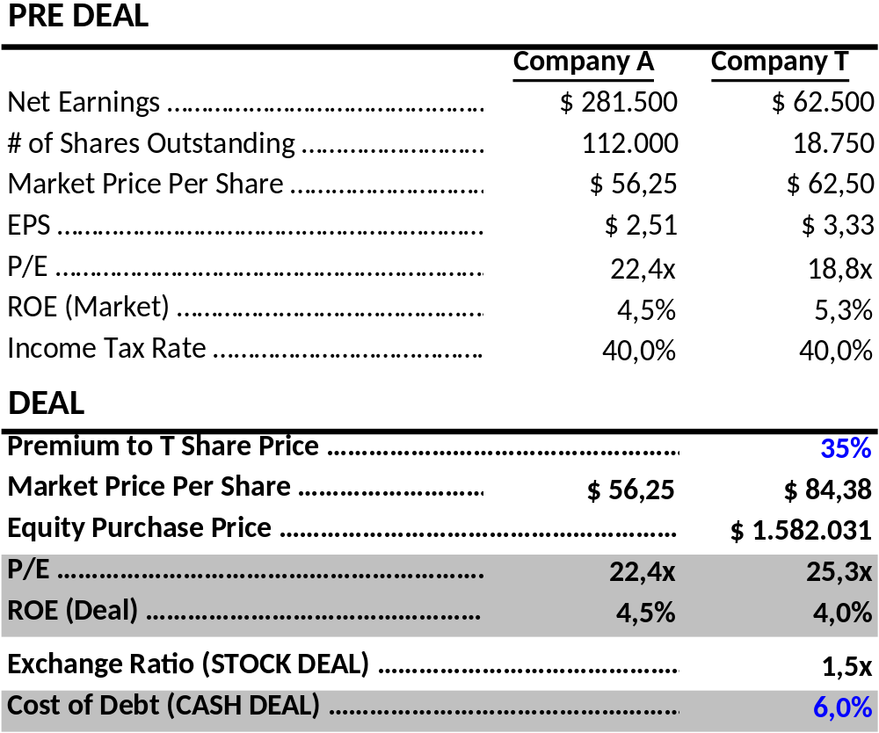
Stock or Cash? Deal Assumptions

Slide 2
Stock or Cash? Deal Assumptions
Purchase Price Premium is 35% = $84.38 (A’s offer price for T)/$62.50 (T’s pre deal market price).

Slide 3
All Stock Deal
All Stock Deal – Deal Assumptions
“A” Plans to Acquire “T” in a Stock-for-Stock Deal With T Receiving $84.38 for Each Share of Its Common Stock (35% premium to T’s Stock Market Price).
A Expects No Change to Its P/E Multiple Post-closing.
No Earnings Growth Due to Synergies.

Slide 4
All Stock Deal
Purchase Price Premium is 35% = $84.38 (A’s offer price for T)/$62.50 (T’s pre deal market price).
Exchange Ratio is 1.5 = $84.38 (A’s offer price for T)/$56.25(A’s pre deal market price).

Slide 5
All Stock Deal
Purchase Price Premium is 35% = $84.38 (A’s offer price for T)/$62.50 (T’s pre deal market price).
Exchange Ratio is 1.5x = $84.38 (A’s offer price for T) / $56.25(A’s pre deal market price).
A will issue 28,125 new shares = 1.5x 18,750 T shares outstanding.

Slide 6
All Stock Deal
Purchase Price Premium is 35% = $84.38 (A’s offer price for T)/$62.50 (T’s pre deal market price).
Exchange Ratio is 1.5x = $84.38 (A’s offer price) / $56.25(A’s pre deal market price).
A will issue 28,125 new shares = 1.5 x 18,750 T shares outstanding.
Total shares of “NEWCO” = 140,125 consisting of 112,000 (A’s pre deal shares outstanding) + 28,125 new shares issued.
Therefore, A’s shareholders end up with 79.9% of NEWCO, while T’s shareholders receive 20.1%

Slide 7
All Stock Deal
A’s pre merger EPS of $2.51 ($281,500/112,000) resulted in a pre merger P/E of 22.4x ($56.25 market price/$2.51 EPS).
T’s pre merger EPS of $3.33 ($62,500/18,750) resulted in T’s deal P/E of 25.3x ($84.38 T’s deal price)/$3.33 EPS)
Therefore, A’s P/E 22.4x < T’s deal P/E 25.3x

Slide 8
All Stock Deal
Purchase Price Premium is 35% = $84.38 (A’s offer price for T) / $62.50 (T’s pre deal market price).
Exchange Ratio is 1.5x = $84.38 (A’s offer price for T) / $56.25 (A’s pre deal market price).
A will issue 28,125 new shares = 1.5 x 18,750 T shares outstanding.
Total shares of “NEWCO” = 140,125 = 112,000 (A’s pre deal shares outstanding) + 28,125 new shares issued.
NEWCO’s Pro Forma EPS is $2.46 = $281,500 (A profits) + $62,500 (T profits) = $344,000/140,125 NEWCO shares outstanding.

Slide 9
All Stock Deal
A’s pre merger EPS of $2.51 resulted in a pre merger P/E of 22.4x ($56.25 market price/$2.51 EPS).
NEWCO’s Pro Forma EPS is $2.46 = $281,500 (A profits) + $62,500 (T profits) = $344,000/140,125 NEWCO shares outstanding.
Thus, NEWCO’s expected share price of $54.94 is calculated from its expected Pro Forma EPS of $2.46 x its P/E multiple of 22.4x.

Slide 10
All Stock Deal
A’s pre merger EPS of $2.51 resulted in a pre merger P/E of 22.4x ($56.25 market price/$2.51 EPS).
T’s pre merger EPS of $3.33 ($62,500/18,750) resulted in T’s deal P/E of 25.3x ($84.38 T’s price/$3.33 EPS)
Therefore, A’s P/E 22.4x < T’s deal P/E 25.3x
Deal P/E Multiple Paid of 25.3x implies an ROE of 4.0% = $3.33 (T’s EPS) / $84.38 (Price/Share Paid for T).
T’s ROE of 4.0 % < A’ ROE of 4.5%.
Thus, this merger deal will result in:
  EPS dilution of $(0.06) per share ($2.46 post deal EPS - $2.51 pre deal EPS) for A.
  A’s share price decrease of $(1.31) per share ($54.94 post deal expected price vs. $56.25 pre deal price)
  A’s shareholders owning 79.9% of NEWCO and T’s shareholders owning 20.1%.

Slide 11
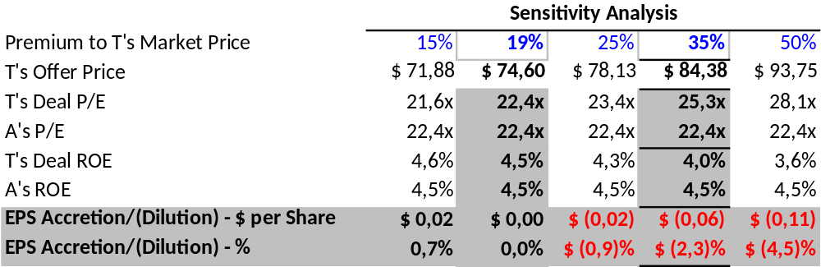
All Stock Deal
The higher the premium (and P/E multiple) paid for T vs. A’s P/E … the lower T’s ROE vs. A’s ROE … the more dilutive the deal
Premium for T has to be lower than 19% … so that deal P/E multiple is lower than A’s P/E multiple (22,4x)

Slide 12
Stock Or Cash? All Cash Deal
All Cash Deal
T Agrees to an All Cash Purchase of 100% of T’s Outstanding Common Stock for $84.38/share (35% Premium).
Deal Financed 100% with Debt.
Debt has annual Interest Cost of 6%.
Income Tax Rate is 40%.

Slide 13
All Cash Deal
Deal Financing Cost After-tax is $56,953 = $84.38 (T deal price) x 18,750 (T shares) x 6% (annual interest) x (1 – 40%) (tax rate)
NEWCO’s Pro Forma EPS = $281,500 (A profits) + $62,500 (T profits) – $56,953 (Deal Financing Cost After-tax) = $287,000/112,000 NEWCO shares outstanding = $2.56.

Slide 14
All Cash Deal
NEWCO’s Pro Forma EPS = $281,500 (A profits) + $62,500 (T profits) – $56,953 (Deal Financing Cost After-tax) = $287,000/112,000 NEWCO shares outstanding = $2.56.
NEWCO’s expected share price of $57.36 is calculated from its expected Pro Forma EPS of $2.56 x its P/E multiple of 22.4x.

Slide 15
All Cash Deal
NEWCO’s Pro Forma EPS = $281,500 (A profits) + $62,500 (T profits) – $56,953 (Deal Financing Cost After-tax) = $287,000/112,000 NEWCO shares = $2.56.
Debt Cost with 6% Annual Interest Rate equals to 3.6% Financing Cost After-tax = 6% x (1- 40% Tax Rate).
Deal P/E Multiple Paid for T of 25.3x implies an ROE of 4.0% = $3.33 (T’s EPS) / $84.38 (Price/Share Paid for T).
T’s ROE of 4.0 % > Financing Cost After-tax of 3.6%.
This deal likely will result in:
  EPS accretion of $0.05 p/share ($2.56 post deal EPS - $2.51 pre deal EPS)
  A’s share price increase of $1.11 per share ($57.36 post deal expected price vs. $56.25 pre deal price)
  A’s shareholders owning 100% of NEWCO

Slide 16
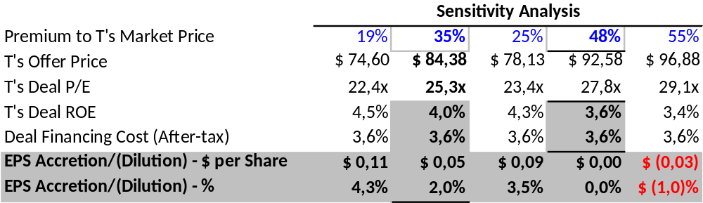
All Cash Deal
The higher the premium (and P/E multiple) paid for T … the lower T’s ROE vs. the After-tax Debt Cost to buy T … the more dilutive the deal
Premium for T has to be higher than 48% for the deal to become EPS dilutive … T’s ROE < Financing Cost After-tax (3.6%)

